Slide 1
WELCOME
TO PROJECT PRESENTATION

Slide 2

Blood Donor Management System: Rokto Lagbe

Slide 3
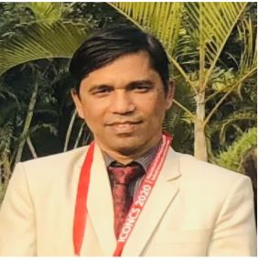
Supervised by Dr. Muhammad Shahin Uddin Professor Department of Information & Communication Technology (ICT) Mawlana Bhashani Science & Technology University (MBSTU)

Slide 4

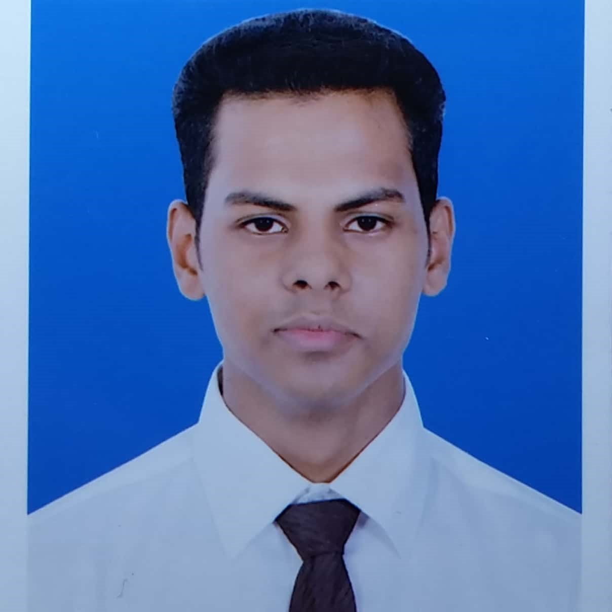
Presented by Monira Akter ID: IT20003 Session: 2019-2020 1st year 2nd semester Dept. of ICT, MBSTU _________________________________________________________________________________________________ Md. Jubayer Alam ID: IT20004 Session: 2019-2020 1st year 2nd semester Dept. of ICT, MBSTU

Slide 5
Overview
Topics | Page no
Objective | 6
Mission | 6
Goal | 6
System Requirements | 7
Motive Behind the Project | 8
Methodology | 9
Who can use & How will the benefited | 10
Other positive sides & features | 11
Analysis of the project | 12
Success Criteria | 13
Limitations | 14
Plan for Future | 15

Slide 6
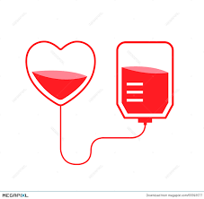
What if Necessary blood of endangered people is possible to provide by a simple software application??

Slide 7
Objective: To show blood donor information with accuracy & swiftness. Our Mission: To build an application which will help endangered or needy people to get their desired blood in time from real donor in the easiest way. Main goal of the project: To help people finding desired blood effectively & Accurately in time.

Slide 8

System Requirements:
Codeblocks Application: easy to operate, free for everyone, uses little ram. (compared to VS code)
Microsoft Windows Operating System
C Programming Language: Simple & Efficient, Faster, Rich built-in function libraries, Structured language.
Storage On Computer: Maximum 150-200 kilobytes.

Slide 9
Motive
Finding Appropriate Donor
Ensure the willingness & availability of the donor
Freed from fraud
Save lives!
Reduce waste of time

Slide 10
Methodology
Identification & selection
Initiation & planning
Analyze system needs
Designing & Developing System
Testing & Implementing
Solving Bugs

Slide 11
Who can use this application? 1. Administration: Justify & ensure the security of the information. 2. People who needs blood: Can search for desired blood group and can contact with donor. 3. Donors: Update their information and availability.
How will they benefited from it?
1. Administration: Take part in social welfare as well as get income from ad. or sponsors. 2. People who needs blood: Can find desired blood easily in shortest time. 3. Donors: Donate blood as early as it’s needed & possible to real endangered people.

Slide 12
Other Positive Sides & Features
Easy to use.
Time saving.
Organized.
Enriched with information.
Data rechecking process by administrator.
Search by category.
See all data at a glance.
Delete unwanted data.
Update data anytime-anywhere.
Valid data input system.

Slide 13

Analysis of the system 1. Blood Requesting process by hospital or blood needed people. 2. Blood Donation Process of the donor.

Slide 14
Success Criteria -Result - Success rate - Statistics

Slide 15
Limitations 1. Not Dynamic. 2. Unusable in MAC or Linux OS 3. Low Security of data.
- Neil Armstrong

Slide 16
Plan for future: 1. Update it’s security. 2. Secure dynamic soln. for bugs. 3. Add donors availability status. 4. Launch globally if it gets any sponsor or donation.
- Neil Armstrong

Slide 17
Thank you
- Neil Armstrong

